Slide 1
My DH Is…
Shawna Ross

Slide 2
Projects
Modernist Literature
Reading Modernism with Machines
Open Modernisms free anthology
Pedagogy
Teaching with the Digital Humanities: A Practical Introduction
Henry James
New New York Edition
Interactive map of transatlantic voyages

Slide 3
Social Media
Geek out about literature in new ways
Participate in a free, asynchronous conference
Hear about and intervene in others’ work in new ways
Keep up with your field with short, daily chunks of time

Slide 4
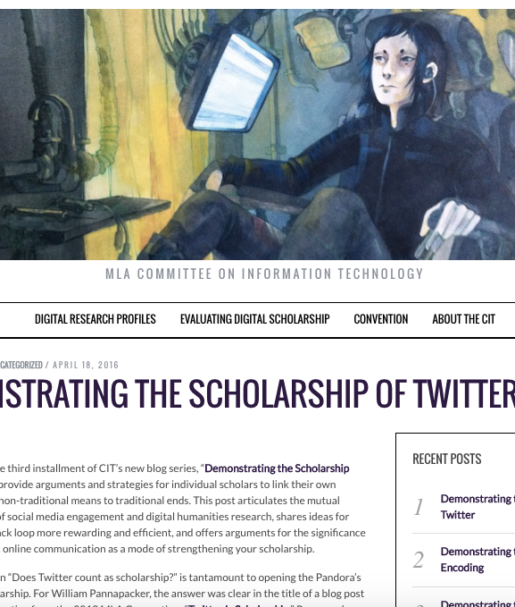
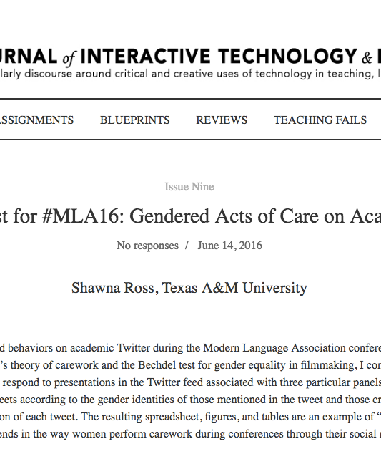
Feedback Loop

